Slide 1


HEP Weekly Report
George Bakas

Slide 2
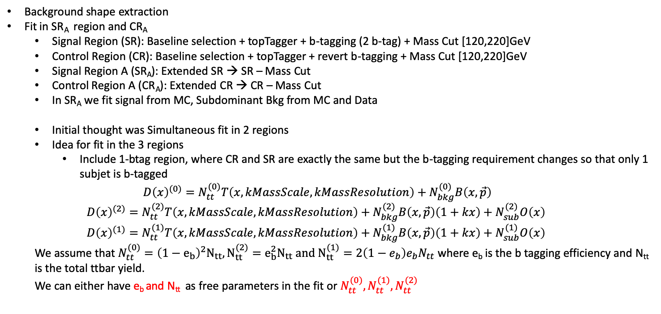
Weekly Report
Background shape extraction
Fit in SR_{A} region and CR_{A}
Signal Region (SR): Baseline selection + topTagger + b-tagging (2 b-tag) + Mass Cut [120,220]GeV
Control Region (CR): Baseline selection + topTagger + revert b-tagging + Mass Cut [120,220]GeV
Signal Region A (SR_{A}): Extended SR → SR – Mass Cut
Control Region A (CR_{A}): Extended CR → CR – Mass Cut
In SR_{A} we fit signal from MC, Subdominant Bkg from MC and Data
Initial thought was Simultaneous fit in 2 regions
Idea for fit in the 3 regions
Include 1-btag region, where CR and SR are exactly the same but the b-tagging requirement changes so that only 1 subjet is b-tagged
$$D{\left(x\right)}^{(0)}=N_{tt}^{(0)}T\left(x, kMassScale, kMassResolution\right)+N_{bkg}^{(0)}B\left(x,\vec{p}\right)$$
$$D{\left(x\right)}^{(2)}=N_{tt}^{(2)}T\left(x,kMassScale, kMassResolution\right)+N_{bkg}^{(2)}B\left(x,\vec{p}\right)\left(1+kx\right)+N_{sub}^{(2)}O\left(x\right)$$
$$D{\left(x\right)}^{(1)}=N_{tt}^{(1)}T\left(x,kMassScale, kMassResolution\right)+N_{bkg}^{(1)}B\left(x,\vec{p}\right)\left(1+kx\right)+N_{sub}^{(1)}O\left(x\right)$$
We assume that $N_{tt}^{(0)}={\left(1−e_{b}\right)}^{2}N_{tt}, N_{tt}^{(2)}=e_{b}^{2}N_{tt} and N_{tt}^{(1)}=2\left(1−e_{b}\right)e_{b}N_{tt}$ where e_{b} is the b tagging efficiency and N_{tt} is the total ttbar yield.
We can either have e_{b} and N_{tt} as free parameters in the fit or $N_{tt}^{(0)},N_{tt}^{(1)},N_{tt}^{(2)}$

Slide 3
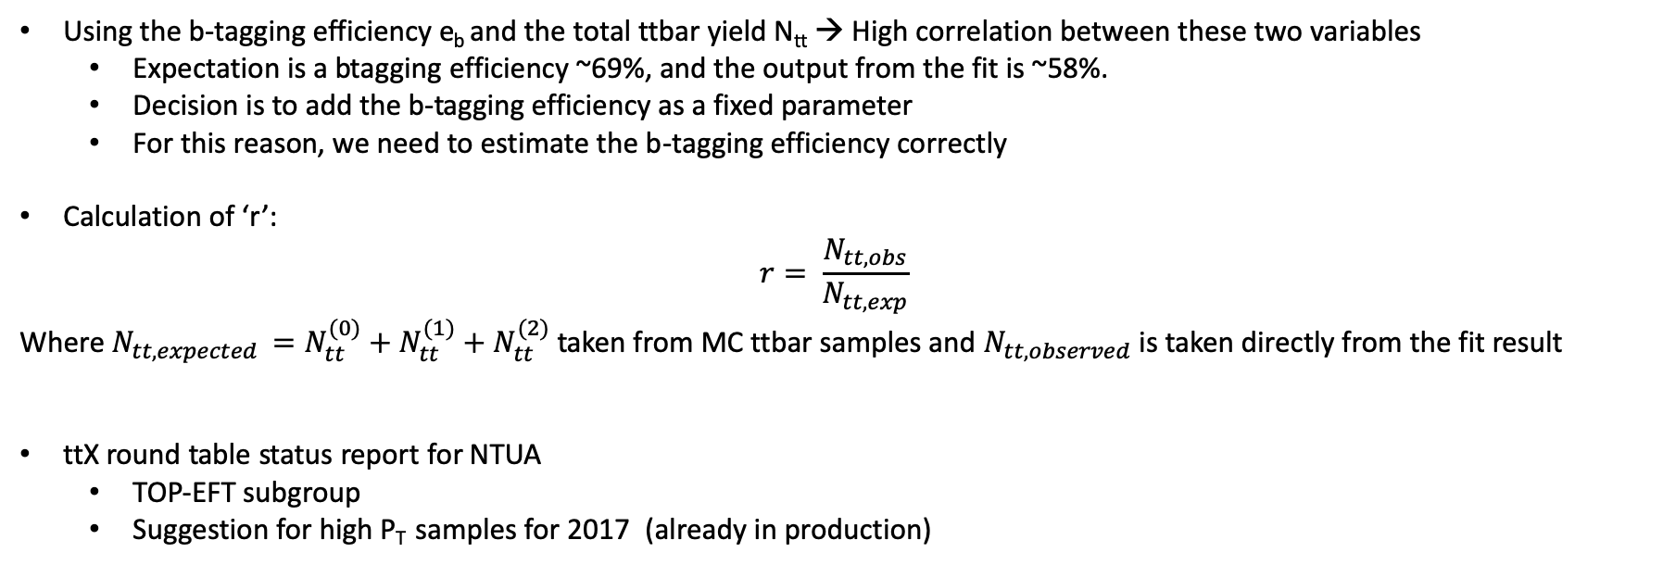
Weekly Report
Using the b-tagging efficiency e_{b} and the total ttbar yield N_{tt} → High correlation between these two variables
Expectation is a btagging efficiency ~69%, and the output from the fit is ~58%.
Decision is to add the b-tagging efficiency as a fixed parameter
For this reason, we need to estimate the b-tagging efficiency correctly
Calculation of ‘r’:
$$r= \frac{N_{tt,obs}}{N_{tt, exp}}$$
Where $N_{tt,expected }=N_{tt}^{(0)}+N_{tt}^{(1)}+N_{tt}^{(2)}$ taken from MC ttbar samples and $N_{tt,observed}$ is taken directly from the fit result
ttX round table status report for NTUA
TOP-EFT subgroup
Suggestion for high P_{T} samples for 2017 (already in production)

